Slide 1
PROJECT ON: RAINFALL PREDICTION USING XGBOOST
Vachana Pitamaha Dr. P.G. Halakatti College of Engineering & Technology, Vijayapur
Computer Science and Engineering Department
February 2022

Slide 2
PROJECT TEAM
STUDENTS
SUHASINI BIRADAR (2BL18CS089)
KOMAL KHANDEKAR (2BL18CS036)
VAISHNAVI NAGUR (2BL18CS102)
KETAN JANAI (2Bl17CS025)
GUIDED BY :
PROF. SANTOSH DEWAR
Asst. Prof. Dept of CSE, BLDEA’s CET, VIJAYAPURA.

Slide 3
CONTENTS :
Introduction
Problem Statement
Literature Review
Proposed System
Motivation
Objective
Requirement Analysis
References

Slide 4
INTRODUCTION
Rainfall is natural climatic phenomena whose prediction is challenging and demanding.
Rainfall means crops; and crop means life. Rainfall prediction is closely related to agriculture sector, which contributes significantly to the economy of the nation.
Accurate information on rainfall is essential for the planning and management of water resources and also crucial for reservoir operation and flooding prevention.
Rainfall has a strong influence on traffic, sewer systems and other human activities in the urban areas.
Nevertheless, rainfall is one of the most complex and difficult elements of the hydrology cycle to understand and to model due to the complexity of the atmospheric processes that generate rainfall and the tremendous range of variation over a wide range of scales both in space and time.

Slide 5
Extreme Gradient Boosting (XGBoost) is an ensemble learning method. Sometimes, relying on the results of a single machine learning model such as J48(which is a decision tree classifier) may not be enough. Although J48 is good enough and had been used in several problems such rain modeling and wildfire modeling.
XGBoost uses boosting. Multiple trees are created sequentially in a way that each one of the next trees tries to reduce the errors from the previous tree.
XGBoost for rainfall prediction. So this research is the first research to use XGBoost for rainfall prediction. XGBoost itself can handle both classification and regression tasks.

Slide 6
LITERATURE REVIEW
RESEARCHER | YEAR | DESCRIPTION
1.Hu | 1964 | He used an adaptive system called Adaline for pattern classification.
2. Cook and Wolfe | 1991 | They presented a neural network to predict average air temperatures. They used back-propagation learning algorithm for this purpose and got satisfactory result
3. Zhang & Scofield | 1994 | They presented an artificial neural network (ANN) technique for heavy convective rainfall estimation and cloud merger recognition from satellite data.

Slide 7
4. Michaelides et al | 1995 | He compared the performance of ANN with multiple linear regressions in estimating missing rainfall data over Cyprus.
5. Kalogirou et al | 1997 | He used feed forward multilayer neural networks for the estimation of precipitation in selected rainfall collecting stations in Cyprus.
6. Toth et al | 2000 | compared short-term rainfall prediction models for real-time flood forecasting. They applied three time series models, auto-regressive moving average (ARMA), ANN and k-nearest-neighbors (KNN) method
7.Chistodoulou et al | 2004 | He used an idea of predicting rainfall rate by using weather radar instead of rain-gauges measuring rainfall on the ground.

Slide 8
8. El-shafie et al. | 2011 | They concluded that the feed forward back propagation ANN can describe the behavior of rainfall-runoff relation more accurately than the classical regression model.
9. Deshpande | 2012 | He proposed Multilayer Perceptron Neural Network as an intelligent tool for predicting Rainfall Time Series.
10. Chau et al | 2013 | He employed several soft computing approaches for rainfall prediction. The proposed preprocessing techniques included moving average (MA) and singular spectrum analysis (SSA).
11. Singh and Borah | 2013 | They used feed-forward back-propagation neural network algorithm for Indian Summer Monsoon Rainfall (ISMR) forecasting.

Slide 10
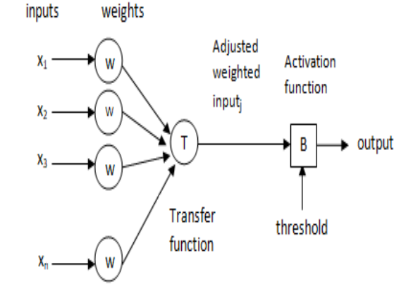
Feed-Forward Neural Network can be visualized as a collection of neurons that act as processing units, constituting multiple layers as shown below

Slide 11
Enhancement made to existing work
We model we tried was the logistical regression model which gave us an accuracy of 84.5% which is better than neural networks but not up to the mark.
The second model we tried to implement was a Decision Tree Classifier this machine learning model gave us an accuracy of 78.3 % which was less accurate than that of logistical regression.
The next we used Random Forest Classifier which gave us an accuracy of 85.4 % which was more than the above models

Slide 12
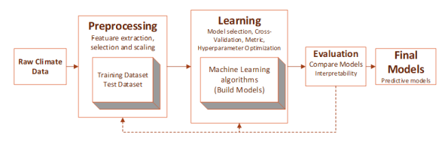
The final model we used to predict the results is XGBOOST Classifier which was giving us an accuracy of more than 86 % which was most suitable for achieving our desired accuracy.
The beauty of this powerful algorithm lies in its scalability, which drives fast learning through parallel and distributed computing and offers efficient memory usage.

Slide 13
MOTIVATION
Rainfall forecasting is very important because heavy and irregular rainfall can have many impacts like the destruction of crops and farms, damage of property so a better forecasting model is essential for an early warning that can minimize risks to life and property and also manage the agricultural farms in a better way.
Keeping track of the prediction of rainfall proves to be one of the primary tasks for well being of mankind.

Slide 14
Objective or Need of Rainfall prediction
The pattern of the rainfall should be regular as too many variations in this pattern may be harmful which can destroy crops and even cause harm to other living organisms. Prediction of rainfall in an accurate manner is a challenging task as it involves the analysis of complex meteorological factors. Among various technologies and methodologies available for predicting rainfall, the main focus of this paper is to provide a simple but effective method for predicting rainfall.

Slide 15
Requirement Analysis
Software requirements:
Programming Language : Python
Operating System : Windows or Linux
Tools : Anaconda Navigator,Tensorflow,Keras,Jupyter Notebook
Hardware requirements:
Processor : Intel Multicore Processor (i3 or i5 or i7or Ryzen5)
RAM : 4GB or Above
Hard Disk : 100GB or Above

Slide 16
8. REFERENCES
1. M.N. Ahuna ,T.J. Afullo, A.A. Alonge, Rain Attenuation Prediction Using Artificial Neural Network for Dynamic Rain Fade Mitigation.SAIEE Africa Research Journal Volume:110 issue:1, 2019
2. Aswin.S, et al., “Deep Learning Models for the Prediction of Rainfall”, International Conference on Communication and Signal Processing, 2018.
3. T.Kashiwao, et al., “A neural network-based local rainfall prediction system using meteorological data on the internet: A case study using data from the Japan Meteorological Agency”, Applied Soft Computing, vol.56, pp.317-330, ISSN 1568-4946, 2017.
4. Reza Mohammadpour, Zahra Asaie, Mohammad Reza Shojaeian, Mehdi Sadeghzadeh, “A hybrid of ANN and CLA to predict rainfall. Arabian Journal of Geosciences”, 2018.
5. Devanshi Shukla, Vidhi Rajvir, Dr.Maulika S.Patel, “Rainfall Prediction using Neural Network”, IEEE, 2018
6. Shilpa Hudnurkar, Neela Rayavarapu, “Prediction of Artificial Neural Network Nowcasting Summer Monsoon Rainfall: A case Study”, IEEE Punecon, 2018.
7. E G Wahyuni, L M F Fauzan,F Abriyani, N F Muchlis,M Ulfa, “Rainfall Prediction with backpropagation method”, International Conference on Mathematics, Science and Education (ICMSE), 2017.
8. R.Arya, et al., “Rainfall Prediction Using an Optimized Genetic-Artificial Neural Network Model”, International Journal of Pure and Applied Mathematics, Volume 119, No. 10, 669- 678, 2018.
9. https://towardsdatascience.com/what-does-rmse-really-mean806b65f2e48

